Slide 1
CAPSTONE PROJECT Resource management based on elastic cloud balancing and job shop scheduling
Name : E.Kaveri
REG NO : 192211493
COURSE CODE : CSA1585
COURSE NAME : CLOUD COMPUTING FOR BIG DATA ANALYTICS FOR BUSSINESS

Slide 2
SI.NO | TOPIC | PAGE NO
1. | ABSTRACT
2. | INTRODUCTION
3. | EXISTING & PROPOSED SYSTEM
4. | LITERATURE SURVEY
5. | IMPLEMENTATION
6. | FUTURE SCOPE & CONCLUSION

Slide 3
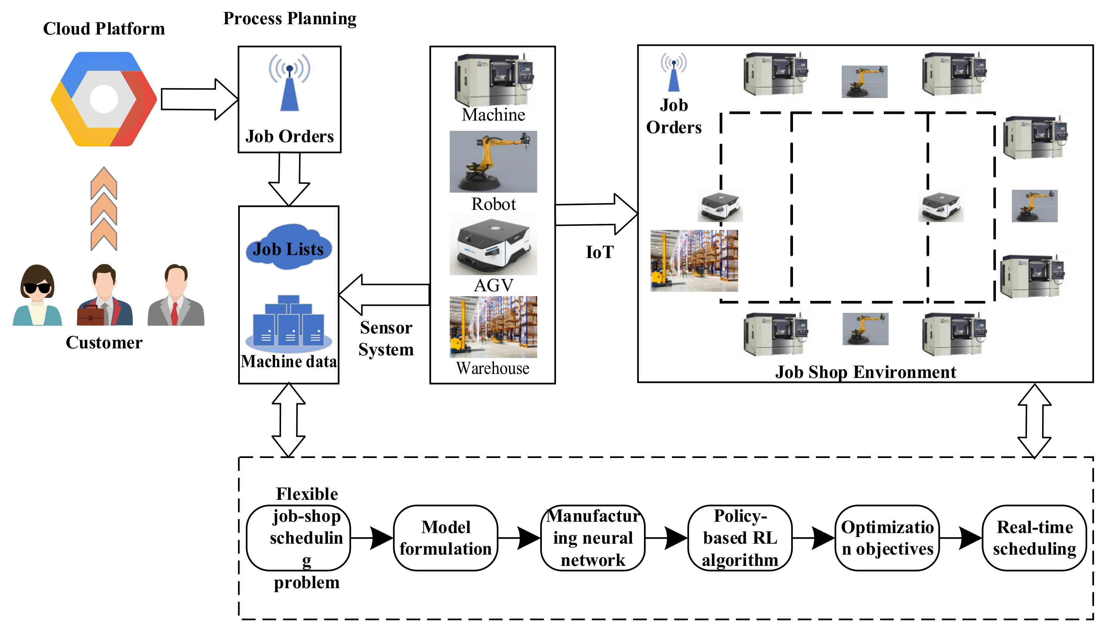
ABSTRACT
This paper proposes an advanced resource management framework that integrates Elastic Cloud Balancing (ECB) with Job Shop Scheduling (JSS) principles to enhance performance, scalability, and cost-efficiency.
Elastic Cloud Balancing leverages the elasticity of cloud resources, dynamically allocating and deallocating computational power based on real-time workload demands.
This approach ensures that resources are optimally used, reducing wastage and improving response times for cloud services.
The elasticity is driven by predictive analytics and real-time monitoring, which helps in anticipating load variations and adjusting resources proactively.
Job Shop Scheduling, on the other hand, is a well-established method in operations research for optimizing the scheduling of jobs on machines

Slide 4
INTRODUCTION
Elastic Cloud Balancing (ECB) is a dynamic resource management technique that leverages the inherent elasticity of cloud environments. By dynamically allocating and deallocating resources based on real-time demand, ECB ensures that computational power is matched precisely to workload requirements.
In parallel, Job Shop Scheduling (JSS) is a well-established approach in operations research focused on the optimal scheduling of jobs on machines, which can be adapted to cloud environments for task scheduling.
JSS aims to optimize the order and allocation of tasks to available resources to minimize completion time and maximize resource efficiency. By considering factors such as task priorities, dependencies, and resource capabilities, JSS provides a structured method to manage the execution of various tasks within a cloud environment.
The combination of these two methodologies can address the limitations of traditional resource management techniques, offering a more robust solution for handling the dynamic and complex nature of cloud workloads.

Slide 5

EXISTING & PROPOSED SYSTEM
The existing systems for resource management in cloud environments have several limitations:
Inefficiency in Handling Dynamic Workloads: Static and simple dynamic methods cannot efficiently manage the highly variable and unpredictable workloads common in cloud environments.
Suboptimal Resource Utilization: Load balancing and traditional scheduling methods do not adequately optimize resource utilization, leading to increased operational costs..
System Architecture
The proposed system consists of the following key components:
Monitoring Module
Predictive Analytics Module
Elastic Cloud Balancer

Slide 6
LITERATURE SURVEY
Elastic Cloud Balancing
Elastic Cloud Balancing (ECB) is a technique that leverages the elasticity of cloud resources to dynamically allocate and deallocate resources based on demand.
Auto-scaling Techniques: Auto-scaling is a well-established method for dynamically adjusting the number of resources allocated to a cloud application. Techniques range from threshold-based scaling, which triggers scaling actions based on predefined metrics, to more advanced predictive scaling, which anticipates future demand using machine learning models
Job Shop Scheduling
Job Shop Scheduling (JSS) is a classical problem in operations research that involves scheduling a set of jobs on a set of machines, where each job has a specific order of operations.
Traditional JSS Algorithms: Algorithms like First-Come, First-Served (FCFS), Shortest Job Next (SJN), and Priority Scheduling are commonly used in job shop scheduling. While these methods are straightforward, they often fail to account for the dynamic nature of cloud environments.

Slide 7
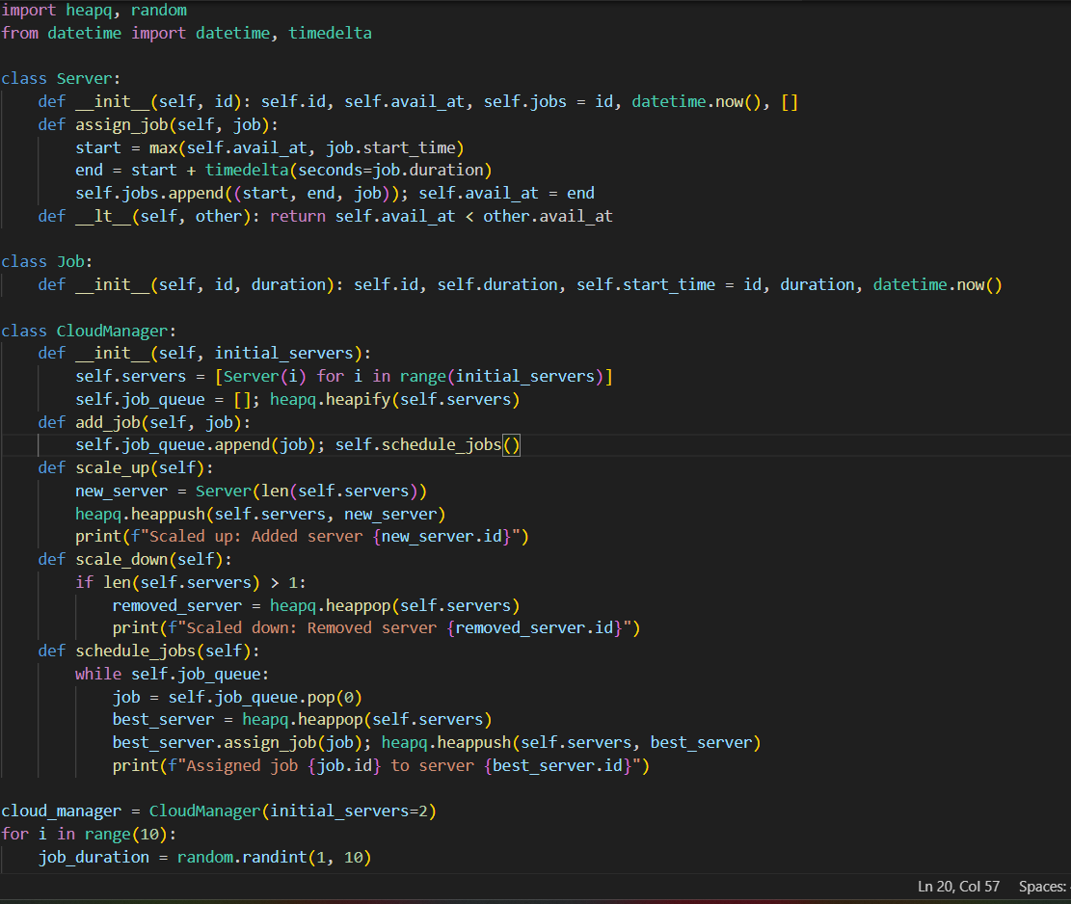
IMPLEMENTATION

Slide 8
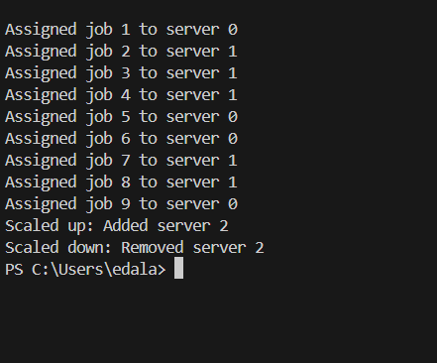
output

Slide 9
FUTURE SCOPE & CONCLUSION
Future Scope
The proposed resource management framework integrating Elastic Cloud Balancing (ECB) and Job Shop Scheduling (JSS) offers a robust solution for dynamic and efficient cloud resource management.
1. Advanced Predictive Analytics
2. Enhanced Scheduling Algorithms
3. Scalability and Performance
Conclusion
Advanced resource management framework that integrates Elastic Cloud Balancing (ECB) with Job Shop Scheduling (JSS) to address the challenges of dynamic and efficient resource management in cloud computing environments.
cost Efficiency: Reducing overprovisioning and minimizing idle resources leads to significant cost savings.

Slide 10


